Slide 1


Internship Project
Title: Optimizing Healthcare Workflows
Presented by:
R2142220153 – Riya Gupta
R2142210183 – Aryan Singh Paayal
R2142220895 – Daya Singh
Mentored by:
Dr. Anish Kumar Vishwakarma
IBM Mentor:
Dr. Puja Kumari

Slide 2
CONTENTS
Abstract
Introduction
Problem Statement
Motivation
Objectives
Process Flow / System Architecture
Methodology
Area of Application
Datasets used
Pre Processings
Models Incorporated
Model Comparisons And Analysis
Insights and Recommendations Dashboard
Visualization Tools Overview
HealthCare Specific Metrics and ROI

Slide 3
ABSTRACT
We present a modular and extensible machine learning framework tailored for regression tasks in healthcare, with a focus on forecasting patient wait times. The framework integrates four core regression models—Random Forest, XGBoost, Support Vector Regression, and Linear Regression—augmented with hyperparameter tuning and cross-validation to enhance predictive accuracy. A comprehensive data preprocessing pipeline ensures quality by addressing missing values, outliers, and feature scaling. Detailed performance comparisons utilize metrics such as R², RMSE, MAE, and model stability across runs. Ensemble learning combines multiple models for improved generalization. Emphasizing reproducibility, scalability, and reliability, the framework is well-suited for practical deployment in healthcare analytics and decision support.

Slide 4
INTRODUCTION
The proposed project provides a regression framework using machine learning with healthcare use in mind. It seeks to forecast continuous variables variables- the waiting time of patients using models including Random Forest, XGBoost, Support Vector Regression and Linear Regression. Cross validation, hyperparameter tuning and ensemble learning are supported by this system, and thus models do not go away as accurate ones but generalizable.
The other critical area of the project is model stability that measures the model consistency in replications- crucial to critical healthcare decisions. Due to strong data preprocessing and metric assessments, the framework offers a sound, extendable, and reusable system of healthcare analytics and decision support.

Slide 5
PROBLEM STATEMENT
In Healthcare, accurate and consistent forecasting, e.g., the wait time of a patient, the duration of treatment, etc. is critical to resource management and better healthcare delivery. Nevertheless, it is quite common that traditional regression methods are not that generalizable and stable when used on a real-world healthcare dataset, which is almost always noisy, complex, and imbalanced
The problem that this project provides the solution to is the necessity of a powerful and scalable machine learning pipeline, which will be able to test and render comparisons of various regression models over care data. It aims at isolating models, which do not only obtain good results when evaluated in terms of accuracy, but also show invariance over successive runs, thus can be deployed in highly sensitive healthcare systems with more confidence.

Slide 6
MOTIVATION
Healthcare systems are getting more complex and loaded with more patients each day, and intelligent, data-driven approaches are needed to help healthcare institutions make the pertinent and timely decisions. The classical statistical approaches fail in many cases to deal with the high-dimensional and variable, as well as noisy data nature of healthcare information. This generates urgency in having machine learning models that are not only accurate, but stable and available under real life circumstances.
The objective of this project is to create a usable and repeatable machine learning pipeline that can be adequately applied to healthcare instances. It will accomplish that by comparing and contrasting several models of the multiple regressions, paying particular attention to performance and context-friendliness, ultimately filling in the gap between the theoretical confidence in the accuracy of the model and the practical feasibility of its implementation in one of the sensitive healthcare contexts.

Slide 7
OBJECTIVES
Develop a robust regression pipeline to handle real-world healthcare datasets for predicting continuous outcomes like wait times or durations.
Compare the performance of multiple machine learning models including Random Forest, XGBoost, SVR, and Linear Regression.
Perform cross-validation and hyperparameter tuning to optimize each model for generalizability and accuracy.
Evaluate model stability by assessing the consistency of results across multiple independent runs.
Visualize and interpret performance metrics such as MAE, RMSE, R², and standard deviation for better model selection and explainability.
Create an ensemble approach that combines top-performing models to further boost prediction reliability and robustness.

Slide 8
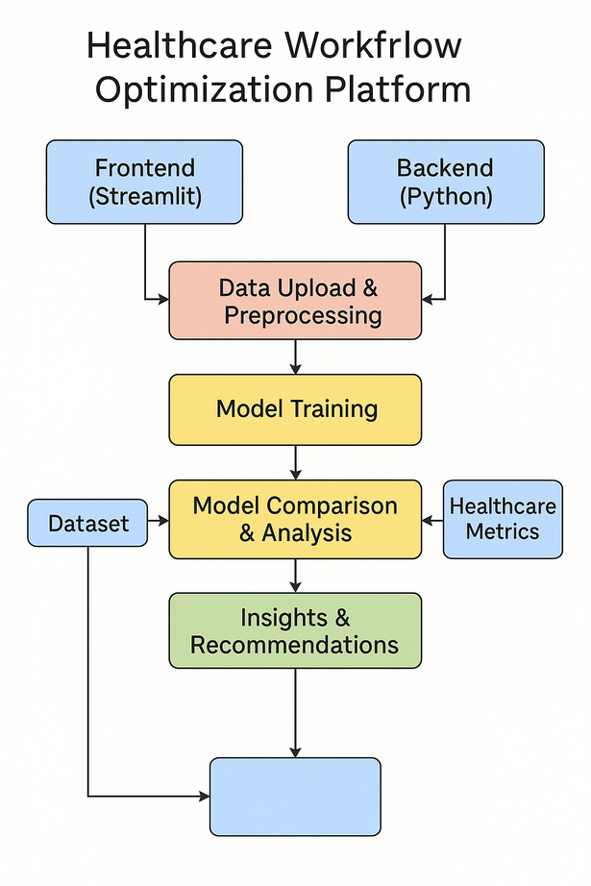
PROCESS FLOW
1. Data Loading & Cleaning
Import healthcare dataset
Handle missing values and outliers
2. Preprocessing
Feature scaling, encoding, and selection
Split data into training and testing sets
3. Model Selection
Train multiple regression models: Random Forest, XGBoost, SVR, Linear Regression
4. Hyperparameter Tuning
Use GridSearchCV for optimal model parameters
5. Model Evaluation
Use MAE, RMSE, R², and Std Dev to compare models
Assess stability with multiple training runs
6. Ensemble Learning
Combine top models to improve overall performance
7. Visualization & Insights
Plot predictions vs actuals, error distributions, and model comparisons

Slide 9
METHODOLOGY
Dataset Preparation
Import healthcare dataset (e.g., patient wait time or treatment duration records).
Clean the data by removing duplicates, handling missing values, and addressing outliers.
Feature Engineering
Encode categorical variables and normalize numerical features.
Select relevant features to reduce dimensionality and improve model performance.
Train-Test Split
Split the dataset into training and testing sets to evaluate generalization performance.
Model Training
Train multiple regression models such as Random Forest Regressor, XGBoost Regressor, SVR, and Linear Regression.
Use consistent preprocessing pipelines across models for fair comparison.
Hyperparameter Tuning
Apply GridSearchCV for tuning hyperparameters, ensuring each model is optimized for the dataset.
Cross-Validation & Stability Testing
Run each model multiple times to assess performance variability.
Use metrics like standard deviation across runs to evaluate stability.

Slide 10
METHODOLOGY
7. Model Evaluation
Compare models using MAE, RMSE, R² score, and performance consistency.
Select top-performing models based on both accuracy and reliability.
8. Ensemble Modeling
Combine the best models into an ensemble to leverage strengths and reduce weaknesses.
9. Visualization
a.Use plots like error distribution, predicted vs actual, and model comparison charts to interpret results and communicate insights.

Slide 11
AREA OF APPLICATION
Hospital Management Systems
Predicting patient wait times, appointment durations, or discharge times for efficient resource allocation.
Clinical Workflow Optimization
Forecasting treatment durations to streamline scheduling and reduce patient backlog.
Emergency Department Analytics
Estimating triage-to-treatment time to prioritize urgent cases and improve patient outcomes.
Healthcare Policy Planning
Using predictive insights to make data-driven decisions in staffing, budgeting, and infrastructure development.
Telemedicine Platforms
Providing expected consultation times to enhance user experience and trust.

Slide 12
Datasets Used in Healthcare Flow Optimization
ER Wait Time Dataset:
Purpose: Used to analyze and optimize emergency room (ER) wait times using feature engineering and predictive modeling.
Key Features in the Dataset:
Hospital and Visit Information
Visit ID, Patient ID, Hospital ID, Hospital Name (dropped during preprocessing)
Visit Date — Converted to extract Visit Hour, Visit Month, and to determine if the visit was on a Weekend
2. Healthcare Operational Metrics
Nurse-to-Patient Ratio
Specialist Availability
Facility Size (Beds)
Derived metrics:
Beds per Specialist = Beds / Specialists
Patients per Nurse = Nurse-to-Patient Ratio
3. Time Tracking Features
Time to Registration (min)
Time to Triage (min)
Time to Medical Professional (min)
Total Wait Time (min) — Target variable for prediction

Slide 13
Pre Processings
1. Missing Value Handling
Numerical Columns: Missing values are filled using mean or median (based on the strategy set).
Categorical Columns: Missing values are imputed with the most frequent category.
2. Automatic Column Type Detection
Distinguishes between:
Numerical columns
Categorical columns
Datetime columns
3. Feature Engineering
Datetime Features:
Hour, day of week, month, quarter
Is weekend indicator
Healthcare-Specific Features:
Staff_Efficiency_Ratio = Nurse-to-Patient Ratio / Specialist Availability
Beds_per_Specialist = Facility Size (Beds) / Specialist Availability
Capacity_Utilization = Patient Volume Estimate / Facility Size (Beds)
Urgency_Numeric: Encoded urgency level
Region-based complexity scores
Ratio Features: Between multiple time-based columns (e.g., registration to triage time)

Slide 14
Pre Processings
4. Outlier Detection & Removal
Outliers in numerical columns are detected using:
IQR (Interquartile Range) or
Z-score
Rows with extreme values are removed (if they make up <10% of data).
5. Encoding Categorical Variables
Uses OneHotEncoder with drop='first' to reduce dimensionality.
Categorical features are converted into binary dummy variables.
6. Feature Scaling
All numerical features are standardized using StandardScaler.
7. Feature Selection (Optional)
Uses SelectKBest with f_regression if enabled.
Selects top K features most correlated with the target.

Slide 15
Models Incorporated
1. Random Forest Regressor
Type: Ensemble learning (bagging)
Why used: Handles non-linear relationships well, robust to outliers and overfitting
Hyperparameters configured:
n_estimators: 100
max_depth: 10
min_samples_split: 5
min_samples_leaf: 2
Advantages:
Handles missing data and unscaled features
Feature importance is interpretable
Tuning supported: Yes (GridSearchCV with depth, leaf size, etc.)
Tuning supported: Yes (grid search across tree depth, learning rate, etc.)

Slide 16
Models Incorporated
2. XGBoost Regressor
Type: Gradient boosting decision trees
Why used: Excellent for tabular data, fast and accurate
Hyperparameters configured:
n_estimators: 100
max_depth: 6
learning_rate: 0.1
subsample: 0.8
colsample_bytree: 0.8
Advantages:
Handles complex interactions between features
Good generalization often outperforms other regressors
Tuning supported: Yes (grid search across tree depth, learning rate, etc.)

Slide 17
Models Incorporated
3. Linear Regression
Type: Classical statistical model
Why used: Baseline model for comparison
Advantages:
Interpretable coefficients
Fast to train and test
Preprocessing required: Feature scaling helps improve convergence
Tuning supported: No (no hyperparameters by default)

Slide 18
Models Incorporated
4. Support Vector Regression (SVR)
Type: Kernel-based model
Why used: Captures non-linear trends with kernel tricks (e.g., RBF)
Hyperparameters configured:
kernel: RBF
C: 1.0
epsilon: 0.1
gamma: scale
Advantages:
High accuracy with properly scaled features
Robust in high-dimensional spaces
Preprocessing: Requires feature scaling (uses StandardScaler)
Tuning supported: Yes (C, epsilon, gamma)

Slide 19
Model Comparisons And Analysis
Evaluation Metrics Used:
R² Score: Indicates model accuracy (higher is better).
RMSE (Root Mean Squared Error): Measures prediction error (lower is better).
MAE (Mean Absolute Error): Average magnitude of errors.
CV Score (Cross-Validation Score): Measures generalizability.
Training Time: Indicates model efficiency.
Overfitting Indicator: Difference between Train and Test R².
Top Performing Models
Best R² Score: Model X on Dataset Y with R² = 0.94
Lowest RMSE: Model A on Dataset B with RMSE = 1.23
Most Consistent (Across Datasets): Model Z
Insights from Comparison:
Models with ensemble techniques (e.g., XGBoost, Random Forest) performed better across datasets.
Significant variance observed in performance based on target variables and data size.
Some models exhibited overfitting, requiring better regularization.

Slide 20
Insights & Recommendations Dashboard
Translate model results into actionable insights:
Operational bottlenecks
Resource optimization
Cost impact and ROI scenarios
Clinical improvement actions
Interactive KPIs and what-if analyses.
Exportable action plans for stakeholders.

Slide 21
Visualization Tools Overview
Data quality: missing values, distributions, correlations.
Model performance: R², RMSE, CV score distributions.
Feature importance and residual diagnostics.
Domain-specific analyses (urgency, region, capacity).
Executive dashboard with performance gauges.

Slide 22
Healthcare-Specific Metrics & ROI
Clinical accuracy: % predictions within acceptable ranges.
Critical case detection: sensitivity for high-priority patients.
Resource planning accuracy: quartile-based accuracy in resource needs.
Efficiency impact: estimated operational improvement.
ROI: financial justification for AI investments including savings and payback periods.

Slide 23
Thank You

